Slide 1


Summary and Key Take-Aways
Professor Subodha Kumar

Slide 2
Supply Chain Management Simulation: Beer Game

Slide 3
Emotions
Take a moment to look back at your feelings and reactions
What were your raw impressions?
Call out some adjectives

Slide 4
Team Strategies
While playing the simulation what did you focus on?
What strategies did you pursue?
Was your game plan successful? Why or why not?
Was there a point at which you changed your strategy?

Slide 5
Team Strategies
Which strategy do you best identify with?
Strategy 1: “Isolationist”
Optimize your own operation in the supply chain (“best I can be”), regardless of the impact on other participants in the chain
Strategy 2: “Cooperative”
Try to help other participants in the chain. For example, not placing an order for the full product quantity needed in order to help a downstream supplier

Slide 6
Team Strategies
Followers of the “Cooperative” Strategy:
How did you implement a cooperative approach?
Alignment for stability by unspoken agreement?
Simple JIT- pass the order on exactly as received?
One participant used to buffer the channel and absorb variability?

Slide 7
How did this happen?
Every chain experienced exorbitant weekly costs!
What do you think contributed to the high amount of backlog across-the-board?
What do you think contributed to the high accumulation of inventory across-the-board?

Slide 8
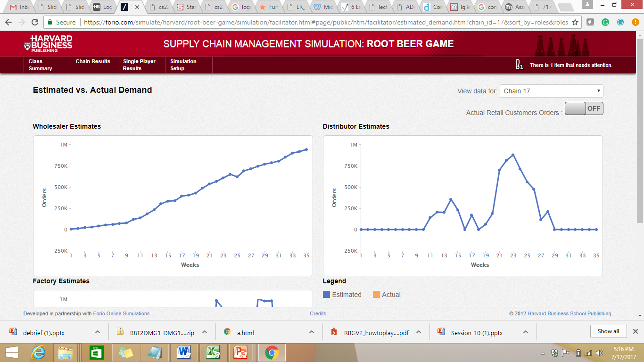
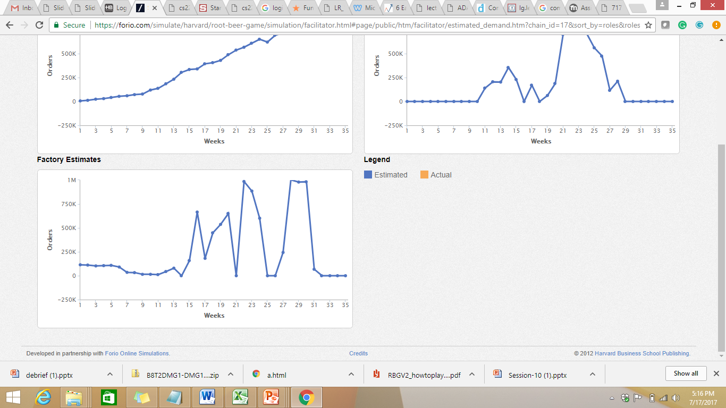
Perceived Customer Demand

Slide 9
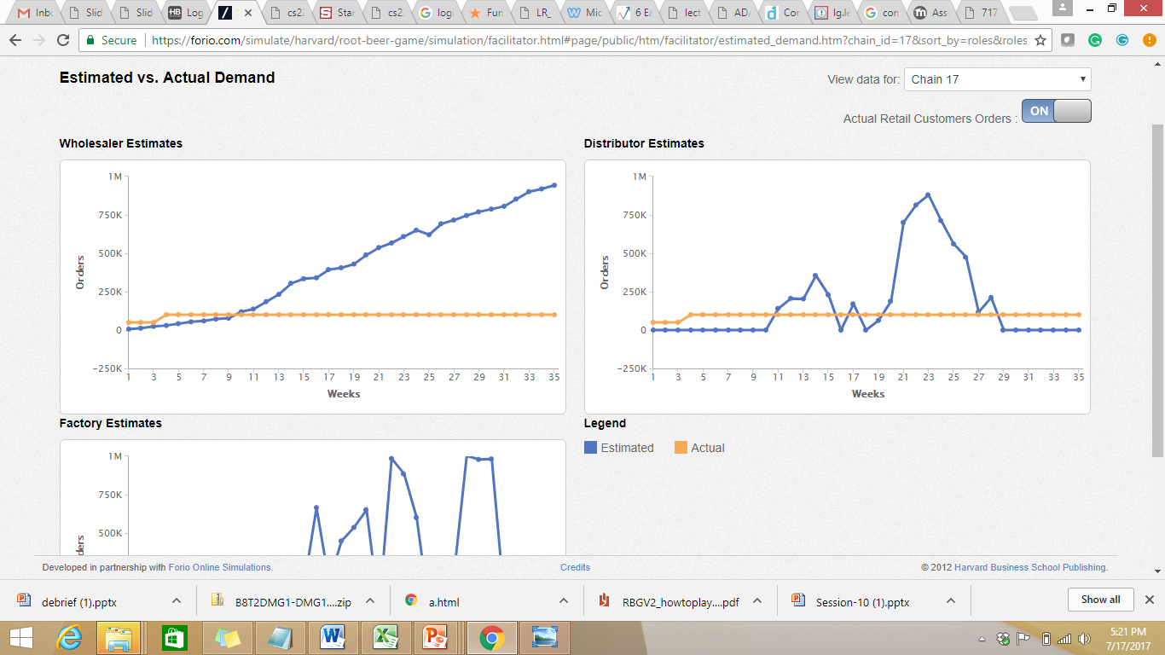
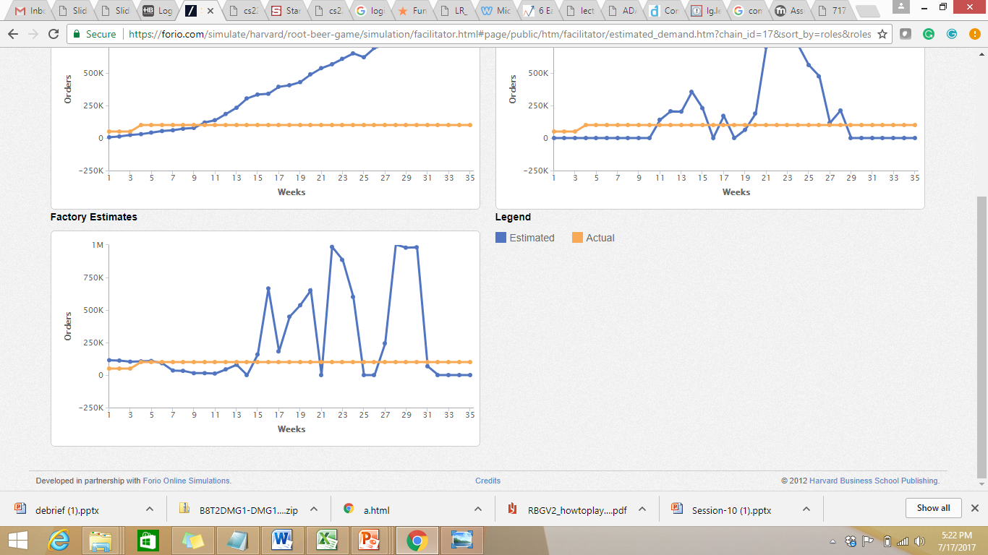
Actual Customer Demand

Slide 10
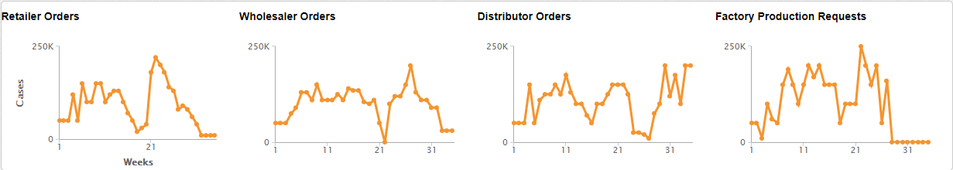
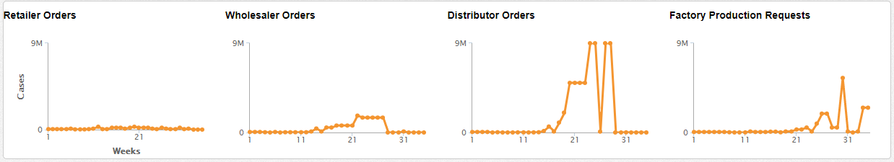
Typical Chain Results

Slide 11
Typical Chain Results
Three main patterns emerge:
Oscillation: inventory/ backlog goes down, then up
Amplification: height of oscillations (and hence costs) increases the farther away one is from the end customer
The distributor usually illustrates significant oscillation because the factory is buffered by having no limits on capacity
Lag: the swings (generally) happen later in time and increase as one goes farther away from the end customer

Slide 12
But Why?
These patterns occur with every single team, so what are the root causes of this performance?
No communication, leading to independent and conflicting solutions
Lag time
Filtered information
“Black box” observing patterns
Bullwhip Effect: the combination of demand variability, combined with the time lag in receiving information

Slide 13
Class Results:

Slide 14
Strategies
As the winning team, what were the strategies you utilized?
What strategies were utilized by the losing team?
Are there any distinct similarities or differences?

Slide 15
Solutions
What structural changes could be used for more effective product flow?
Development of a procedure for week-to-week fluctuations
Reduction of time lags (resulting in fewer players)
Reduction of lead times (less lag between order and fulfillment)
Allowing a single participant control over the movement of goods by transferring decision rights to that participant

Slide 16
Conclusion of Beer Game
This highly simplified example allows you to start thinking about business techniques that provide better supply chain management
One product, one channel, and one participant at each stage
How can we apply what we’ve learned to other industries and products?

Slide 17
Overall Learning
Supply Chain
Facility Location and Network Design
Transportation
Pricing and Revenue Management
Uncertainty, Coordination, and Forecasting
Optimization
Regression
Logit
Maximum Likelihood
Beer Game
Data Analytics

Slide 18
Overall Learning
Different Types of Supply Chains
Supply Chain in Traditional Manufacturing, e.g., Toyota, HP
Newer Supply Chain, e.g., Amazon, Netflix
Service Supply Chain, e.g., Google, Facebook, Uber

Slide 19

IT-Driven Competitive Strategies
Two ways for disruptive competitive strategies enabled by IT
by eliminating industry bottlenecks or choke points that limit supplies or demands
by building a two-sided platform that interconnects customers and suppliers

Slide 20
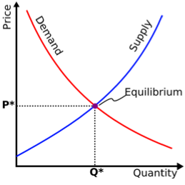
Industry Bottlenecks or “Choke Points”
Prevalent market inefficiencies that structurally limit supplies or demands in an industry
With limited supplies, customers have to pay higher prices.
With limited demands, firms cannot make enough profits.
Notes:
20

Slide 21
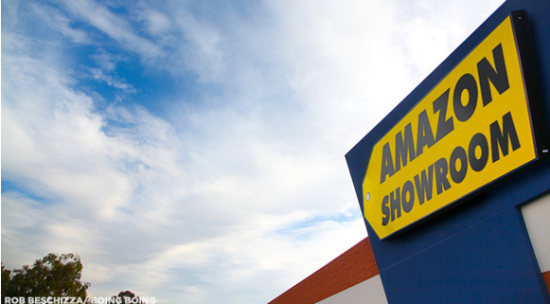
BestBuy, a.k.a Amazon Showroom

Slide 22
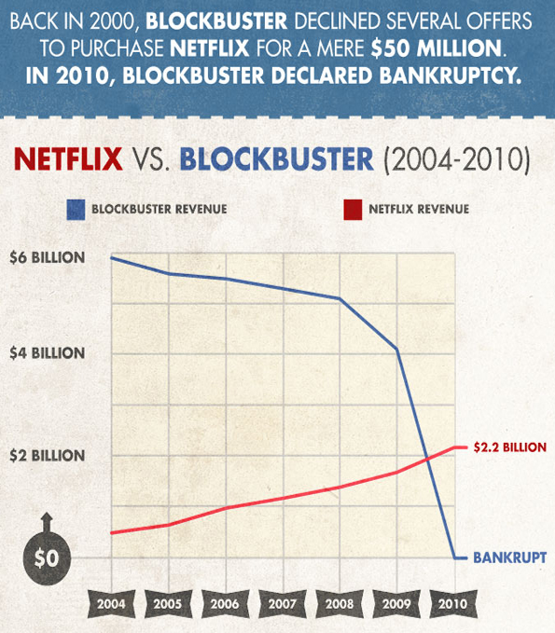

Slide 23
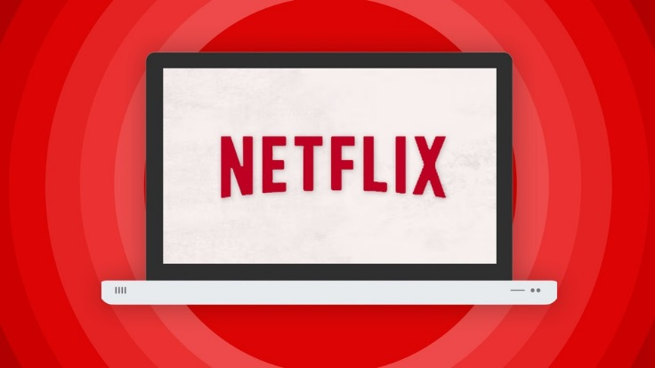
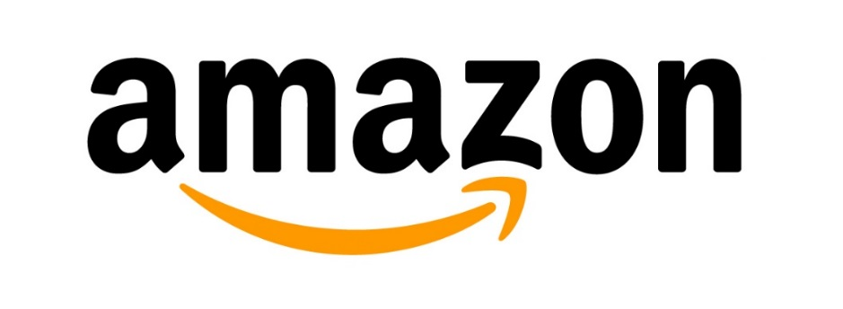
Amazon.com and Netflix (1/2)
What bottleneck do Amazon.com and Netflix eliminate?
How do they use IT to do so?
Notes:
23

Slide 24
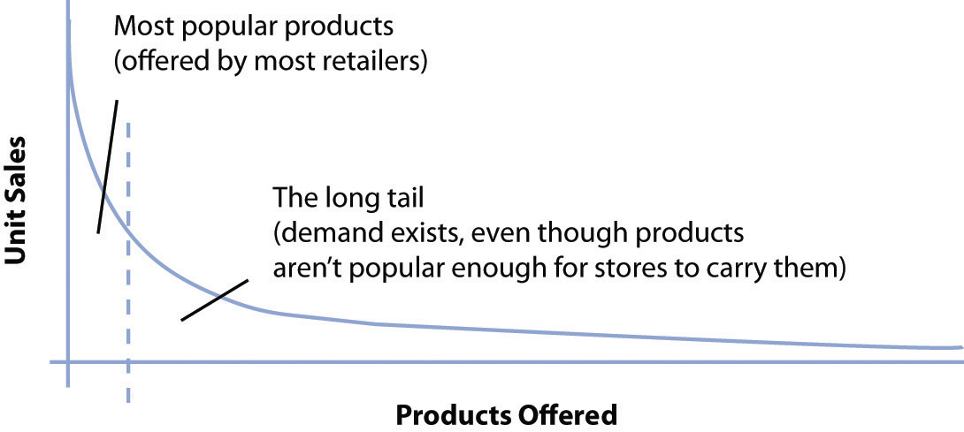
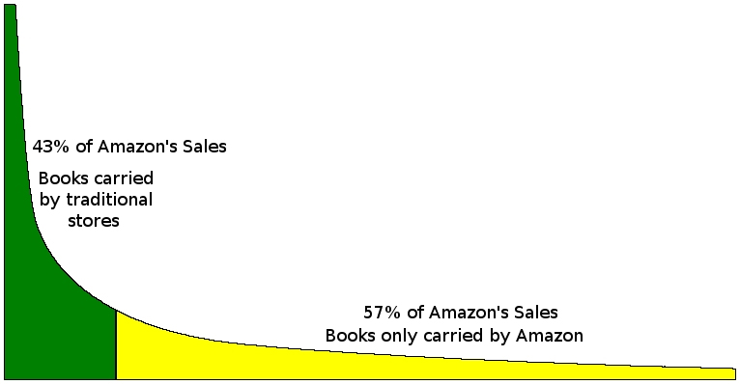
Long Tail Economics (1/2)

Slide 25
Operating Costs
in Offline Stores
Long Tail Economics (2/2)
Revenues
# of products in online is virtually unlimited.
Operating Costs
in Online
# of products
in offline stores
# of Available Products

Slide 26

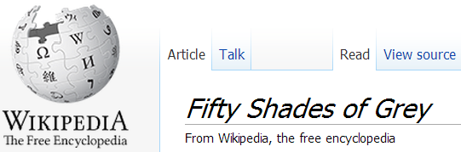
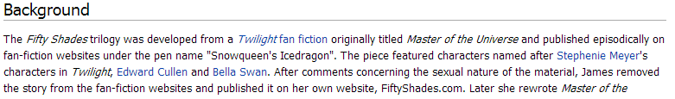
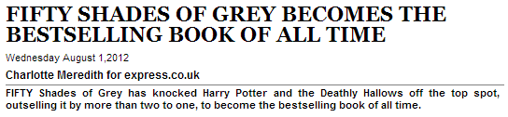

Slide 27
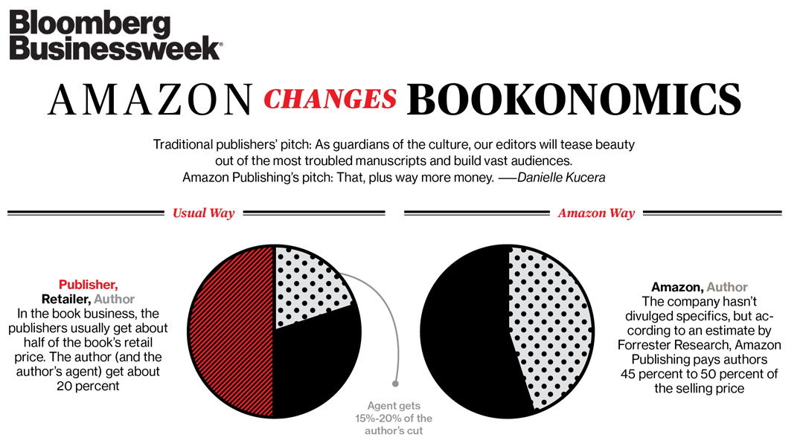

Slide 28
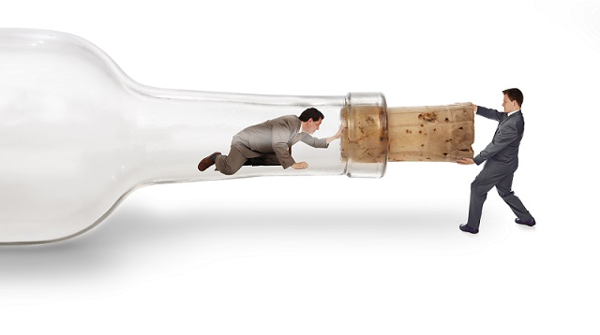
Amazon.com and Netflix (2/2)
Both companies addressed bottlenecks in the traditional retail industries created by limitation in physical spaces.
disrupted the industries by making “long tails” possible.
eliminating choke points created by middlemen
publishers (between authors and readers)
cable operators (between content providers and viewers)

Slide 29
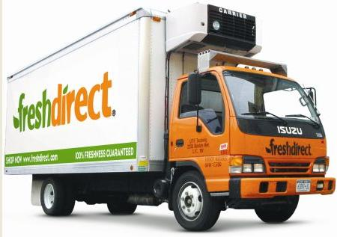
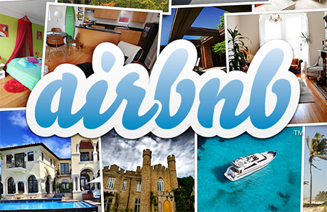


Any Other Example? (1/2)
How do FreshDirect, Uber, Airbnb, and Khan Academy try to disrupt the existing industries by address which bottlenecks?
Notes:
29

Slide 30
Any Other Example? (2/2)
FreshDirect, Uber, Airbnb, and Khan Academy address the following choke points or inefficiencies in the existing industries.
limited space at grocery stores and limited selection for customers
heavily regulated amount of taxicab fleets and pricing
untapped lodging spaces in urban downtowns
limited classroom space and one-size-fits-all education

Slide 31

Bottleneck in Your Industry?
Is there industry-wide inefficiency in your industry that structurally limits supplies or demands?
Can technology and analytics eliminate this inefficiency?
How can you take advantage of technologies
to uncover unserved demands or
to unleash untapped supplies in your industry?
Notes:
31

Slide 32

Anyone has ever used Airbnb?
Anyone who has found an apartment to stay at Airbnb?
Anyone who has rented your apartment to a guest at Airbnb?
Why is Airbnb so popular?
Notes:
32

Slide 33
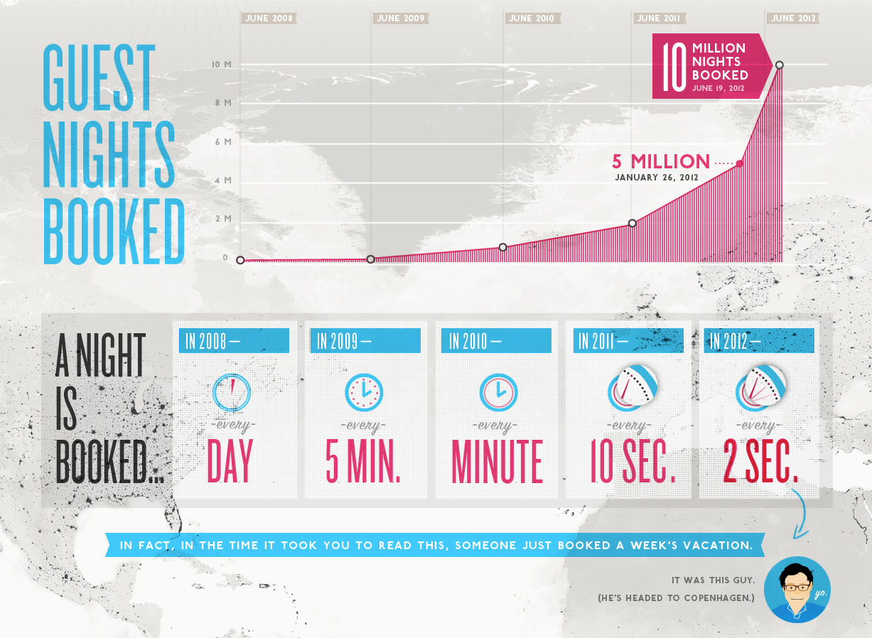

Slide 34
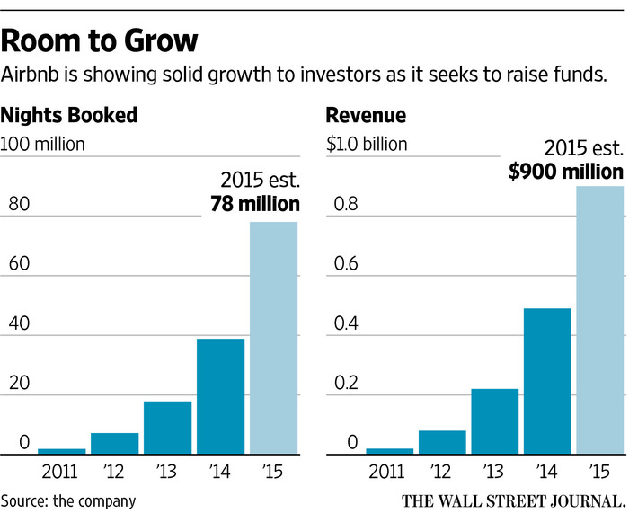

Slide 35
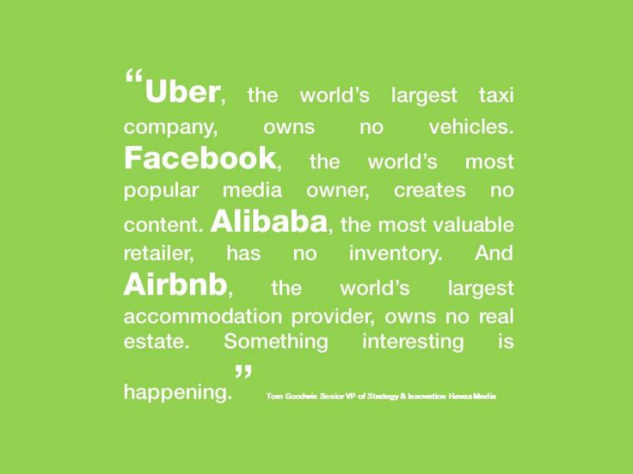
https://www.pinterest.com/pin/123286108528135231/

Slide 36
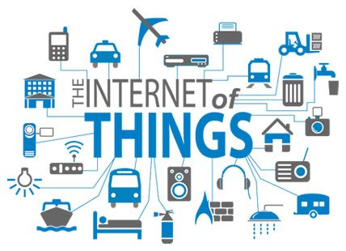
Internet of Things (“IoT”)
Coined in 1999

Slide 37
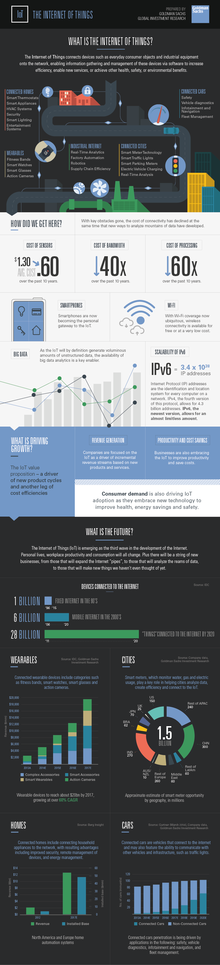
Internet of Things (“IoT”)

Slide 38
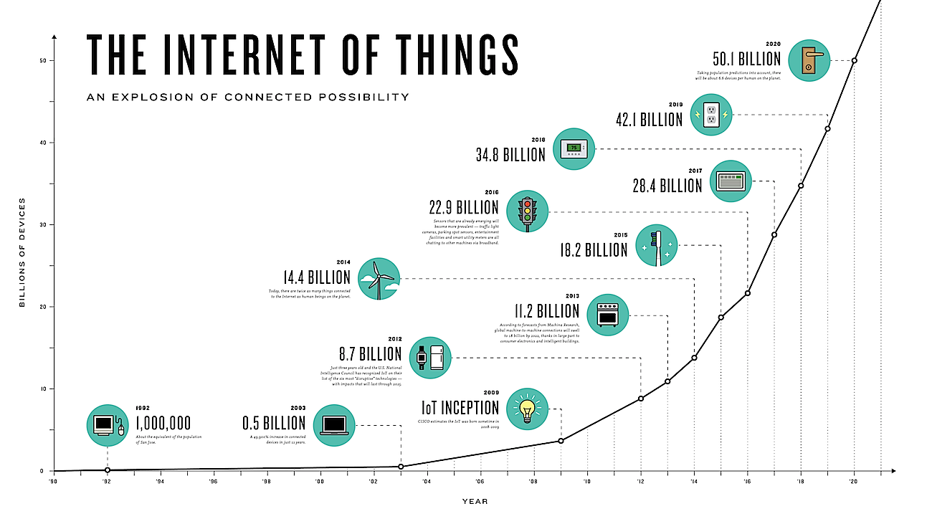
Internet of Things (“IoT”)

Slide 39
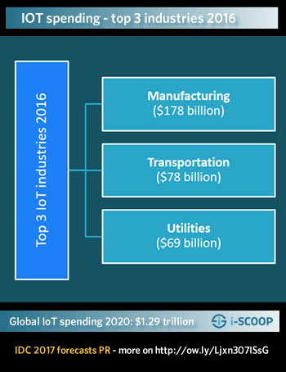
Internet of Things (“IoT”)

Slide 40
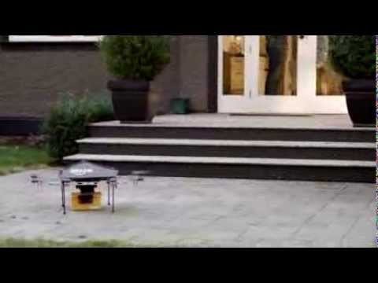
Amazon Prime Air

Slide 41
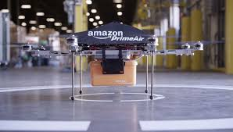
Amazon Prime Air-First Delivery

Slide 42
Amazon 30-Min Delivery
Impact on Supply Chain?
Notes:
How

Slide 43
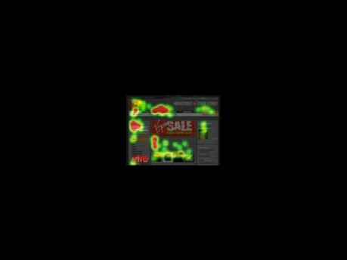
Eye Tracking
Notes:
How

Slide 44
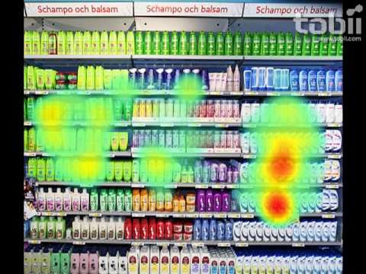
Mobile Eye Tracking: Retailing
Notes:
How

Slide 45
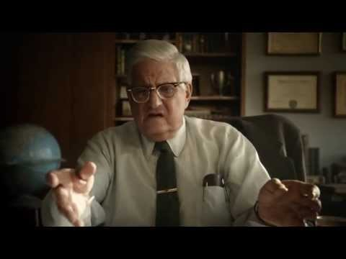
Supply Chain Breakdown

Slide 46
Book and Book Chapters
https://www.amazon.com/Optimization-Issues-Mobile-Advertising-SpringerBriefs/dp/3319186442
http://pubsonline.informs.org/doi/abs/10.1287/inte.1120.0644
http://pubsonline.informs.org/doi/abs/10.1287/opre.2016.1553
https://books.google.co.in/books?id=L8eEDgAAQBAJ&pg=PT944&lpg=PT944&dq=subodha+kumar+routledge
https://books.google.co.in/books?id=L8eEDgAAQBAJ&pg=PT944&lpg=PT944&dq=subodha+kumar+routledge
Notes:
How

Slide 47
Overall Learning
Understand and know about supply chain
How data analytics is used in supply chain to manage uncertainty
Specific real-world examples and cases
How are emerging technologies going to transform supply chain
What would be the role of data analytics
In addition to answering questions, this course was also meant to raise questions
You can answer questions only if you know how/when/why to raise questions
Notes:
How

